Slide 1
Time Series Analysis – Exponential Smoothing Methods for Forecasting

Slide 2
Contents
Forecasting Using Smoothing Methods
Exponential Smoothing in R
Single Exponential Smoothing
Double Exponential Smoothing
Triple Exponential Smoothing
Exploring Built-In Time Series Data in R

Slide 3
Forecasting Using Smoothing Methods
Random, unexplained variation in a time series can have an undesirable impact on forecasts
Smoothing can cancel or reduce such impacts
Smoothing can either be Simple (using Moving Averages) or Exponential
Exponential Smoothing Methods
Single
Exponential
Smoothing
Double
(Holt’s)
Exponential
Smoothing
Triple Exponential Smoothing
(Holt-Winters)

Slide 4
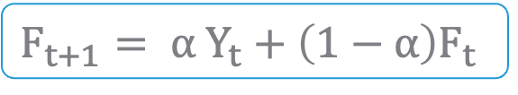
Single Exponential Smoothing Model
Mathematical Model :
Where,
F_{t+1} : Forecast value for period t + 1
F_{t} : Forecast value for period t
Y_{t} : Actual value for period t
α : Alpha (Smoothing constant)
$$F_{t+1}= α Y_{t}+\left(1−α\right)F_{t}$$
*
Note that here we use the dataset “Sales Data for 3 Years”

Slide 5
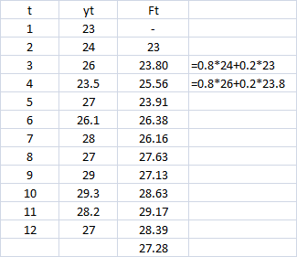
Single Exponential Smoothing Model
Assume α=0.8
*
1st future value will always be the previous value & then for rest future values exponential smoothing mathematical formula is applied.

Slide 6
Single Exponential Smoothing Model - Smoothing Constant α
Values of α
close to one → have less of a smoothing effect and give greater weight to recent changes in the data
closer to zero → have a greater smoothing effect and are less responsive to recent changes
There is no formally correct procedure for choosing α. Sometimes the statistician’s judgment is used to choose an appropriate factor.
Alternatively, α can be decided based on statistical measure such as Root Mean Squared Error.

Slide 7
Get an Edge!
Why the Name “Exponential”?
This method gives weights to past observation in exponentially decreasing manner.
F_{t+1}= α y_{t} + α(1- α) y_{t -1} + α(1- α)² y_{t} ₋₂ + α(1- α)³ y_{t -3}-----
= α y_{t} + (1- α) [α y_{t} -₁ + α(1- α) y_{t -2} + α(1- α)² y_{t -3}----]
= α y_{t} +(1- α) F_{t}
Larger alpha gives more weight to recent values.

Slide 8
Exponential Smoothing in R
#Importing the Data
salesseries<-ts(salesdata$Sales,start=c(2013,1), end=c(2015,12), frequency=12)
#Single Exponential Smoothing
fit1<-HoltWinters(salesseries, beta=FALSE, gamma=FALSE) predict(fit1,n.ahead=1) fit1
HoltWinters() undertakes exponential smoothing.
beta = FALSE and gamma = FALSE ensures single exponential smoothing is performed.
*
Note that here we use the dataset “Sales Data for 3 Years”

Slide 9
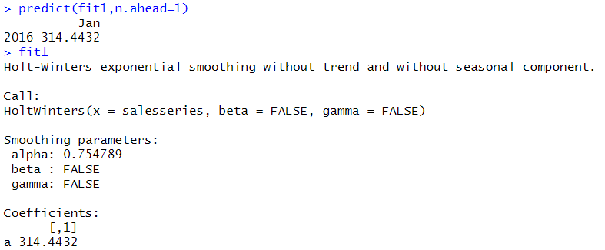
Exponential Smoothing in R
# Output
Interpretation :
It returns predicted future value & value of alpha.

Slide 10
Double (Holt) and Triple(Holt-Winters) Exponential Smoothing Methods
Double exponential smoothing has two equations
First equation is similar to single exponential smoothing method
Second equation updates trend using constant beta.
Double exponential smoothing method is used when there is a trend in the time series.
Triple exponential smoothing has three equations
First 2 equations are similar to double exponential smoothing method
Third equation updates seasonal component using constant gamma.
Triple exponential smoothing method is used when there is trend + seasonality in the time series.

Slide 11
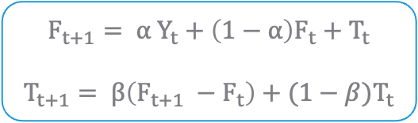
Double Exponential Smoothing Model
Mathematical Model :
Where,
F_{t+1} : Forecast value for period t +1
F_{t} : Forecast value for period t
T_{t} : Trend component for period t
T_{t+1} : Trend component for period t +1
Y_{t} : Actual value for period t
α : Alpha (Smoothing constant)
β : Beta (Second smoothing constant)
$$F_{t+1}= α Y_{t}+\left(1−α\right)F_{t}+T_{t}$$
$$T_{t+1}= β\left(F_{t+1} −F_{t}\right)+(1−β)T_{t}$$

Slide 12
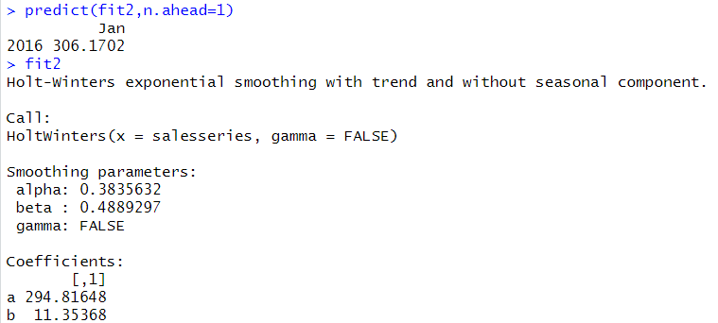
Double Exponential Smoothing in R
#Double Exponential Smoothing
gamma = FALSE ensures double exponential smoothing is performed.
fit2<-HoltWinters(salesseries, gamma=FALSE) predict(fit2,n.ahead=1) fit2
# Output
Interpretation :
It returns predicted future value, value of alpha and beta.

Slide 13
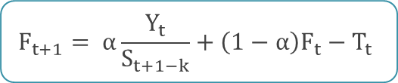

Triple Exponential Smoothing Model
Mathematical Model :
where,
$$F_{t+1}= α\frac{Y_{t}}{S_{t+1−k}}+\left(1−α\right)F_{t}−T_{t}$$
$T_{t+1}= β\left(F_{t+1} −F_{t}\right)+\left(1−β\right)T_{t}$ $S_{t}= γ\frac{Y_{t}}{F_{t−k}}+\left(1−γ\right)S_{t+1−k}$
S_{t+1-k} : Seasonal smoothing value for period t +1
F_{t} : Forecast value for period t
F_{t+1} : Forecast value for period t +1
F_{t} : Forecast value for period t
T_{t} : Trend component for period t
T_{t+1} : Trend component for period t +1
Y_{t} : Actual value for period t
α : Alpha (Smoothing constant)
β : Beta (Second smoothing constant)
$γ$ : Gamma (Third smoothing constant)

Slide 14
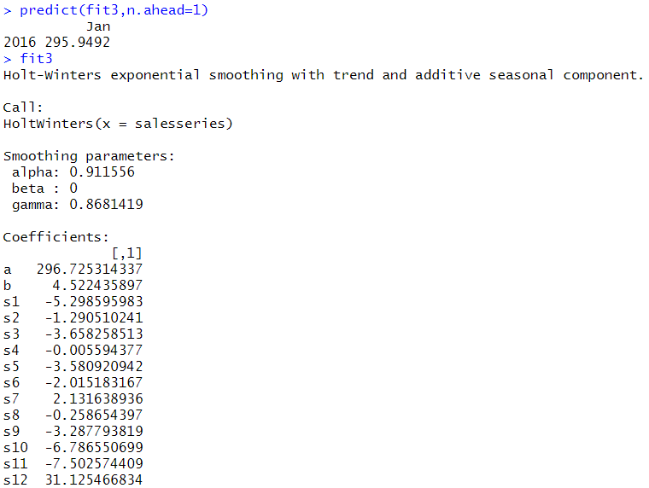
Triple Exponential Smoothing in R
#Triple Exponential Smoothing
fit3<-HoltWinters(salesseries) predict(fit3,n.ahead=1) fit3
# Output
Interpretation :
It returns predicted future value & value of alpha, beta and gamma.

Slide 15
Get an Edge!
Always approach time series analysis in a systematic manner
Analyse
Analyse trend and seasonality present in the data
Decompose
Decompose time series into its components
Forecast
Forecast future values of the time series
For vector time series, investigate connections between two or more time series with the aim of using values of some of the processes to predict those of the others. (Eg. Pairs trading in stock market)

Slide 16
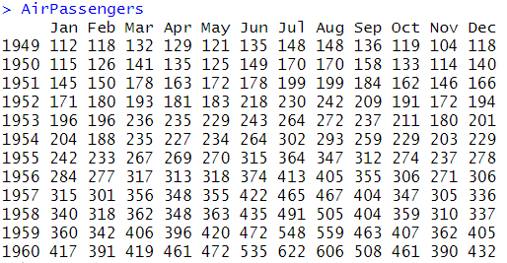
Exploring Built-In Time Series Data in R
#Fetching the Data
data("AirPassengers") AirPassengers
AirPassengers() is Box-Jenkins data, with monthly totals of international airlines passengers (in thousands) from 1949 to 1960.
# Output

Slide 17
Exploring Built-In Time Series Data in R
# Checking Data Features
class() returns class of the data. AirPassengers data is a time series.
class(AirPassengers) [1] "ts" start(AirPassengers) [1] 1949 1 end(AirPassengers) [1] 1960 12 frequency(AirPassengers) [1] 12
start() and end() return the first and last values in the data.
frequency() returns information about frequency of time points in the data, i.e. whether monthly, daily, etc.
Interpretation :
The data is of class ts.
The database starts at year 1949, month 1 and ends at year 1960 and month 12.
Frequency = 12 suggests that the data is monthly.

Slide 18
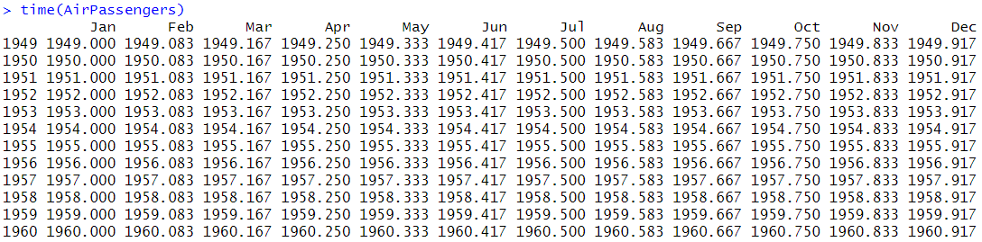
Exploring Built-In Time Series Data in R
# Exploring Data
time(AirPassengers)
time() shows time at which the time series was sampled.
# Output
Interpretation :
The output shows time for each observation as year followed by time stamp.
Time stamp for Jan it’s 0/12, Feb it’s 1/12,……. So on till Dec it’s 11/12.

Slide 19
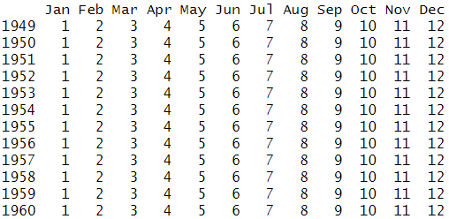
Exploring Built-In Time Series Data in R
cycle(AirPassengers)
cycle() shows positions of each observation in the cycle.
# Output
Interpretation :
The output shows frequency of data points, represented numerically

Slide 20
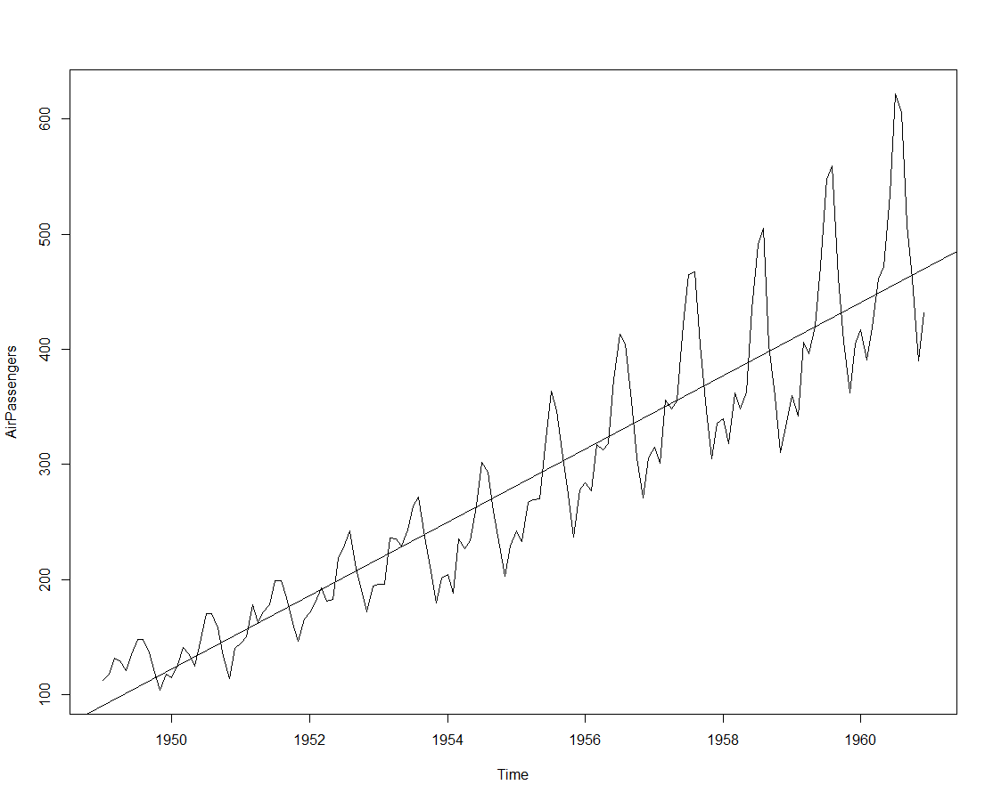
Plotting Data with Trend Line
# Plotting Data with Trend Line
plot(AirPassengers) model<-lm(AirPassengers~time(AirPassengers)) abline(model)
plot() returns a simple line plot of the entire data.
lm() fits a linear regression model on the data with observations as dependent variables and time stamps as independent variables.
abline() adds a straight line to the plot.
# Output
Interpretation :
The plot shows a positive trend.

Slide 21
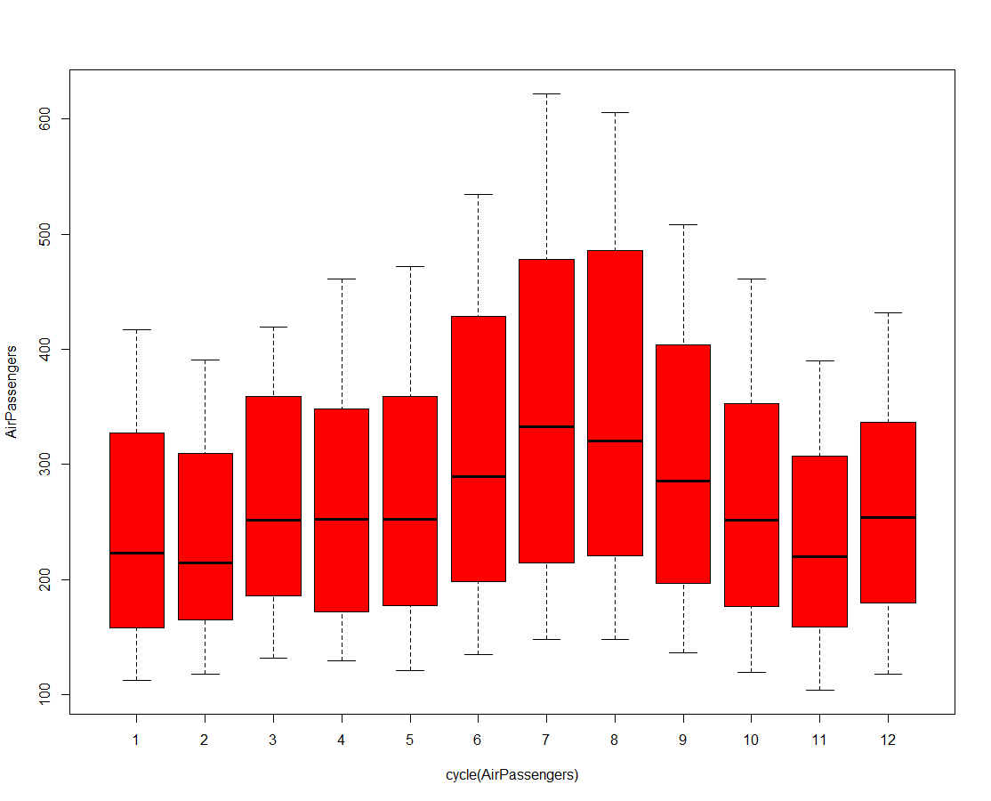
Box Plot with Cycles
#Box Plot for Cycle
boxplot(AirPassengers~cycle(AirPassengers),col="red")
boxplot() generates a Box-plot for data cycles.
# Output
Interpretation :
The plot gives a clear indication that number of passengers in the months of July and August were higher than the rest.

Slide 22
Quick Recap
In this session, we learnt about time series exponential smoothing:
Smoothing
Smoothing gives weights to past observations, in order to give more significance to seasonality and trend components of a time series.
Smoothing in R
Use HoltWinters() to carry out exponential smoothing

